Slide 1
Journey Scrapbook
Week 1
Yuvraj Singh
Emp ID - 655486

Slide 2
18th Aug 2023
Introduction to Business Analysis
SDLC Model
Requirement Analysis
Use case Diagram
Management Techniques
Waterfall Model
Agile and Scrum
Team activity - Roleplay

Slide 3
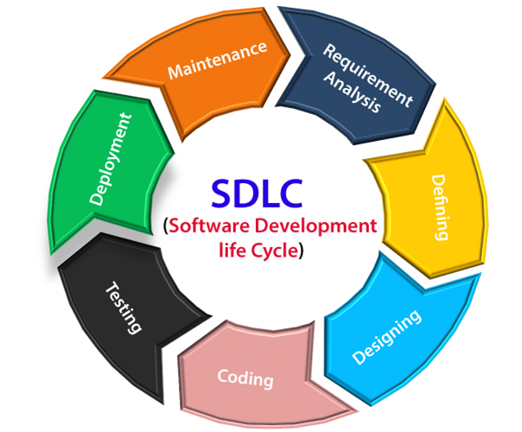
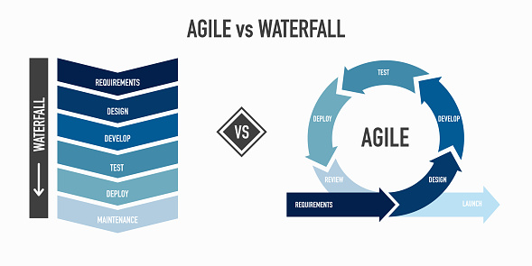

Slide 4
21st Aug 2023
Epic, User Story, Task, Sub Task
Story point Estimation
Definition of Ready
Definition of Done
Scrum and Kanban Board
Project Failures
Sprint Backlog
Values and Principles of agile

Slide 5
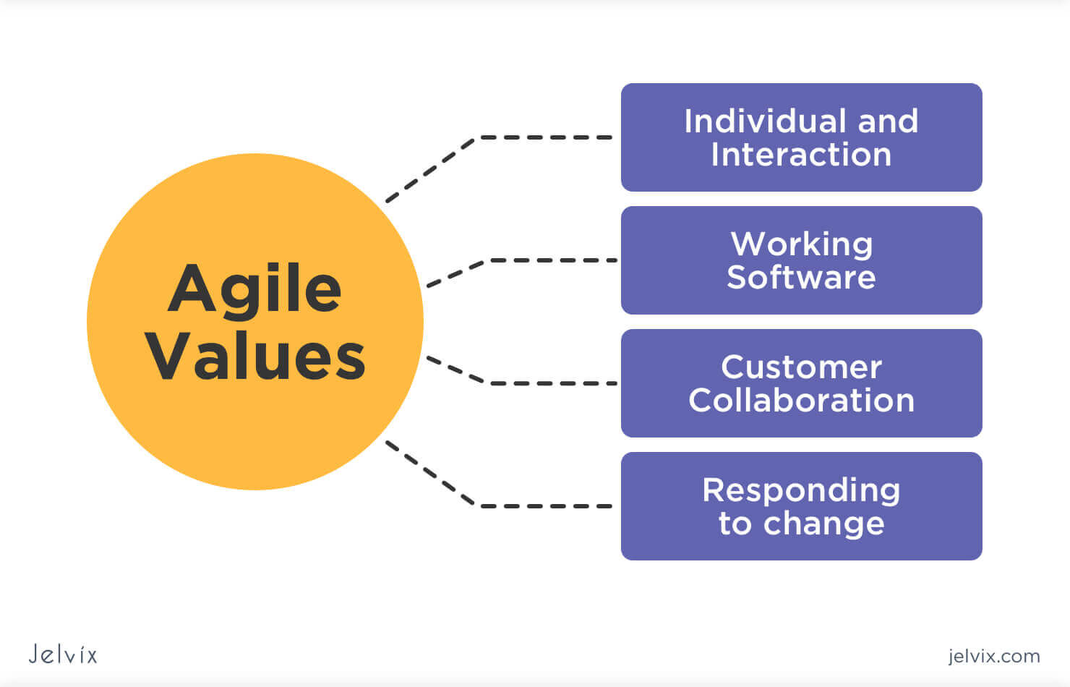
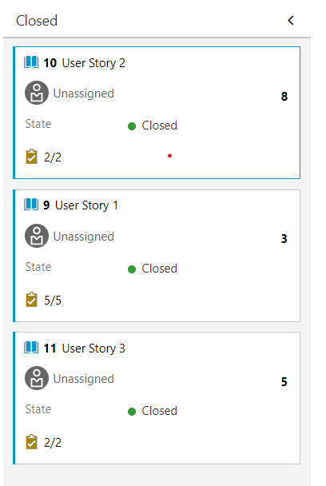
Scrum Board

Slide 6
22nd Aug 2023
Introduction to DBMS
Tasks of a DBMS
Types of DBMS
SQL
Normalization and its Types
Different types of Joins
EXISTS, DISTINCT , etc. Operators
Team Activity – Schema planning

Slide 7
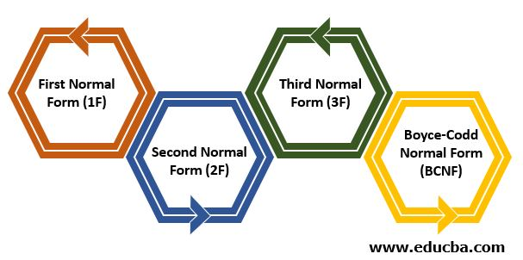
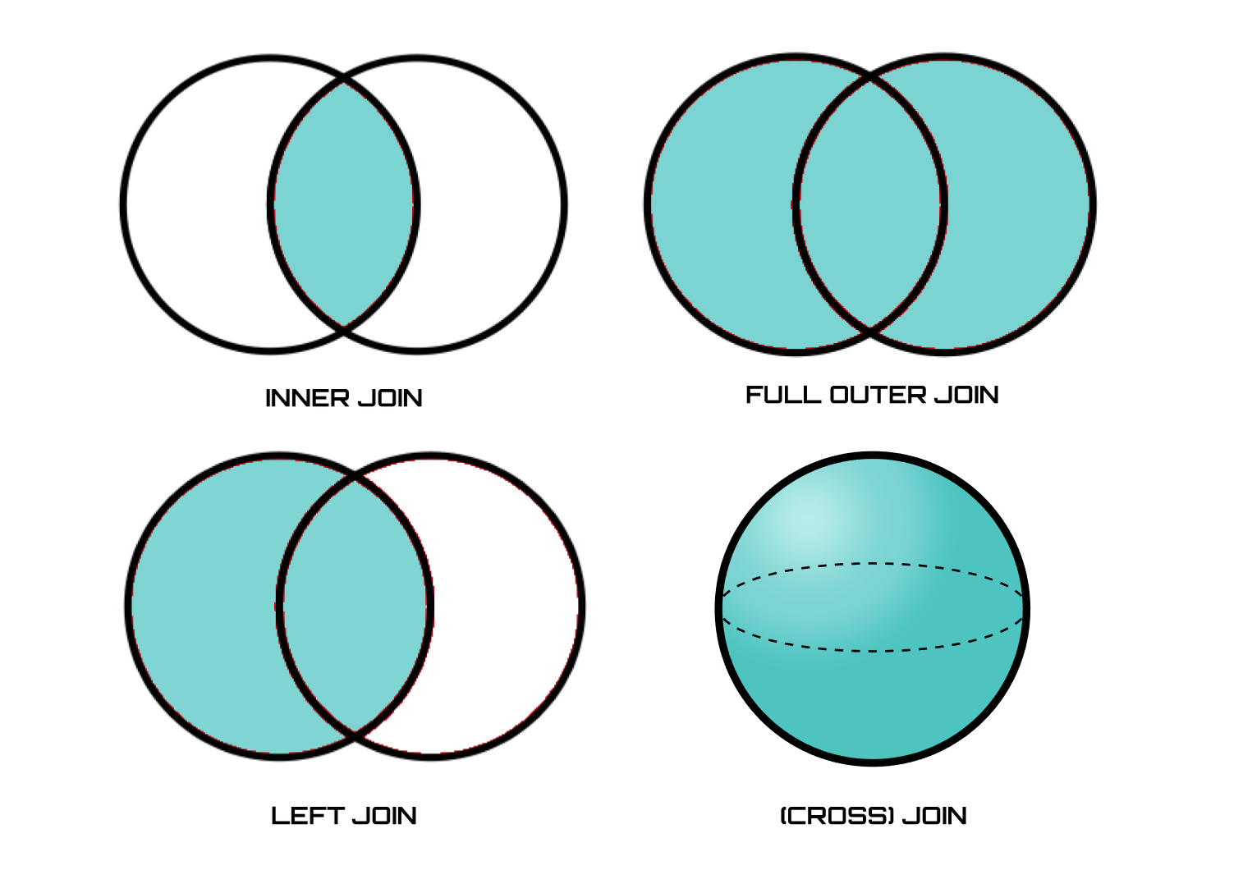
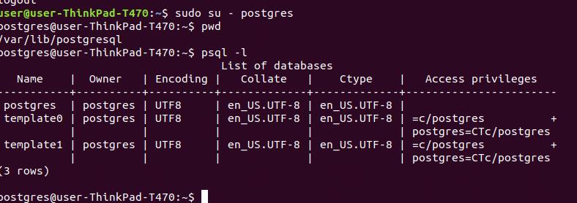

Slide 8
23rd Aug 2023
Introduction to Software Testing
Software Failures
Importance of software testing
Software Test Life Cycle and its phases
STLC vs SDLC
Testing Triangle
Types of Software Testing
Test Driven Development

Slide 9
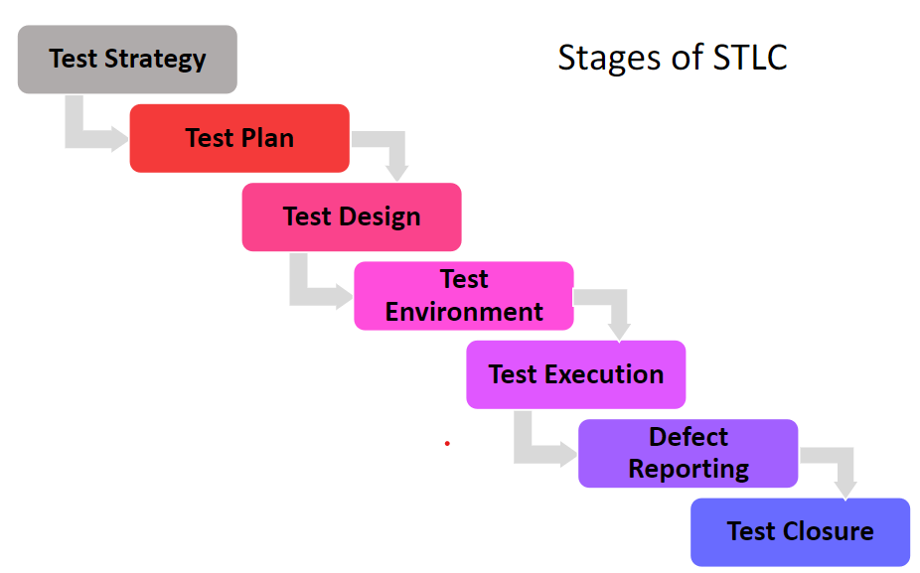

Slide 10
24th Aug 2023
Introduction to DevOps
DevOps Lifecycle
DevOps Tools
DevOps Principles
CI/CD
GitHub Actions
Benefits of GitHub Actions
Components of GitHub Actions

Slide 11
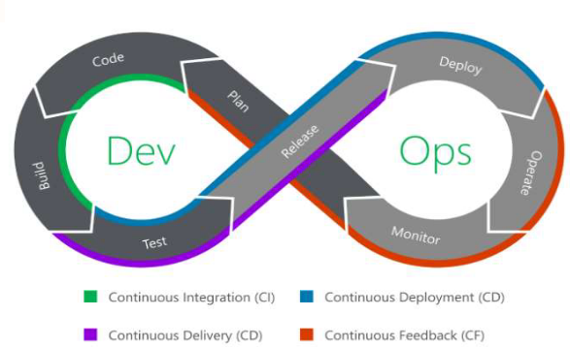
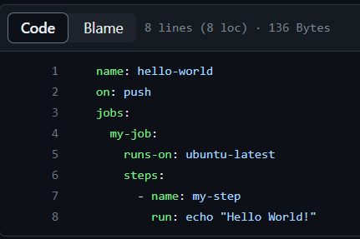
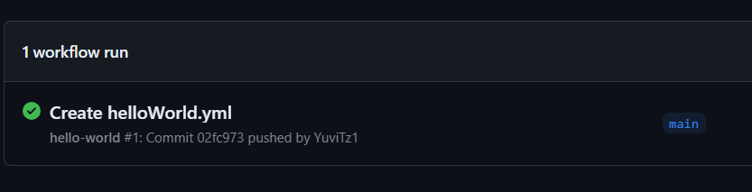
GitHub Actions Workflow

Slide 12
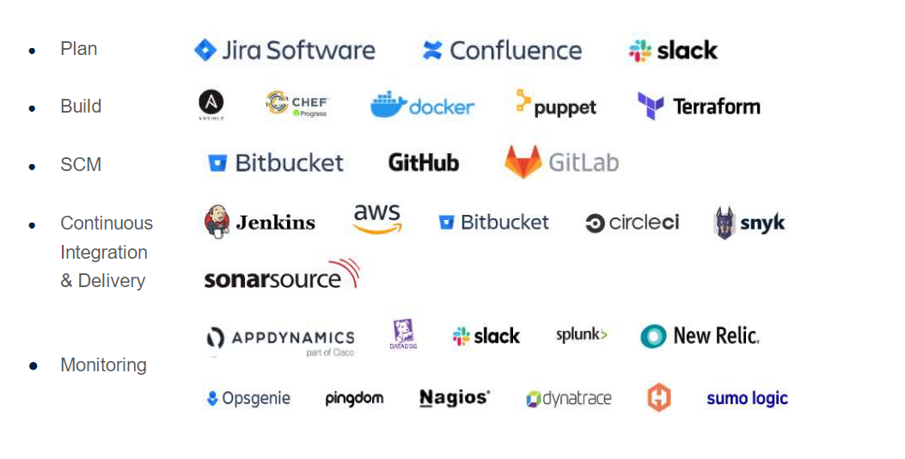
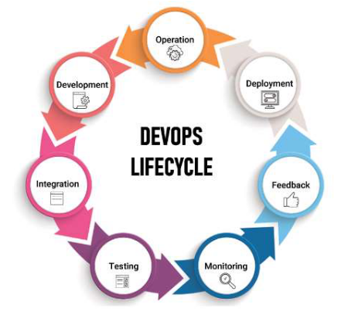
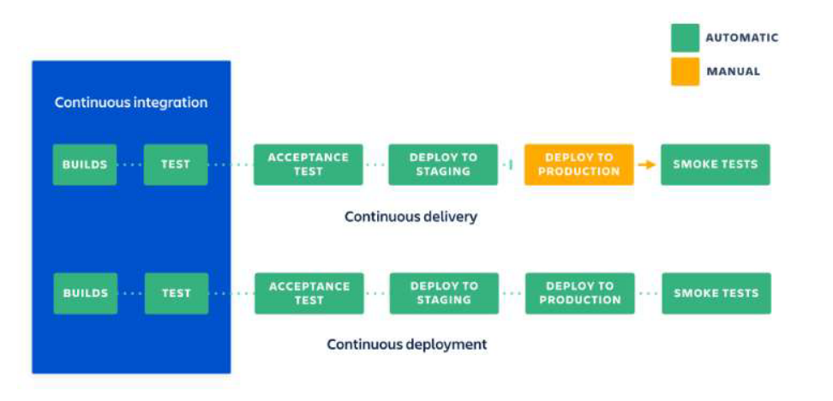

Slide 13
25th Aug 2023
Introduction to Cloud Computing
Cloud services Models
Software as a service
Platform as a service
Infrastructure as a service
Cloud Computing Service layers
Virtualization
Microsoft Azure virtual machines
Cloud Sourcing
Cloud Storage
Advantages/Disadvantages of cloud computing

Slide 14
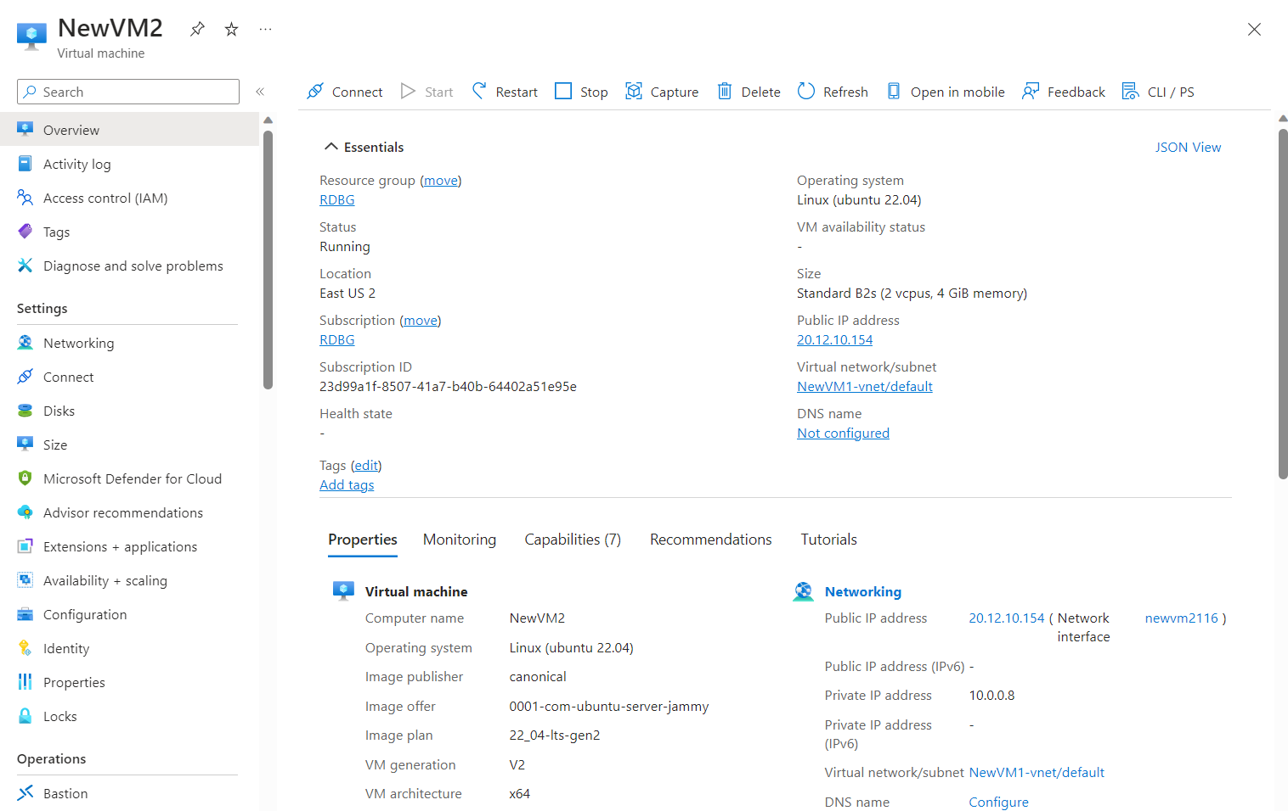
Virtual Machine on Azure

Slide 15
28th Aug 2023
Foundational Bootcamp Final case study
Problem Statement - Implementing a Seamless CI/CD Workflow for a Spring Boot Application using Azure Boards, Azure, Git, Maven, Docker, Github, Github Action

Slide 16
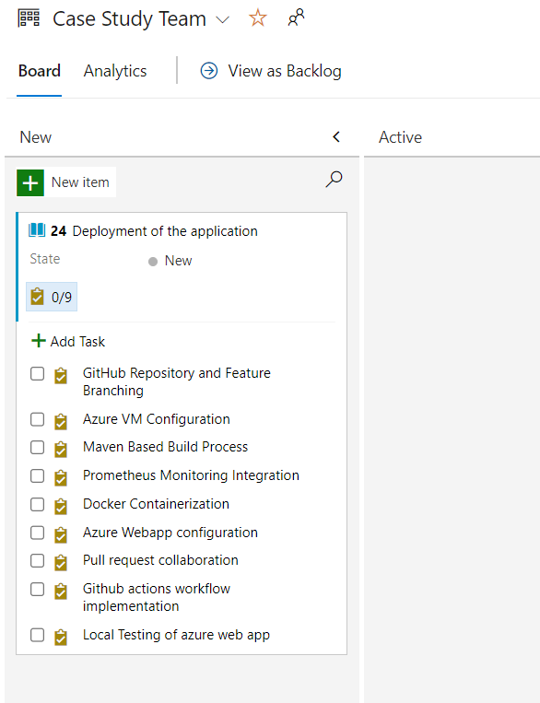
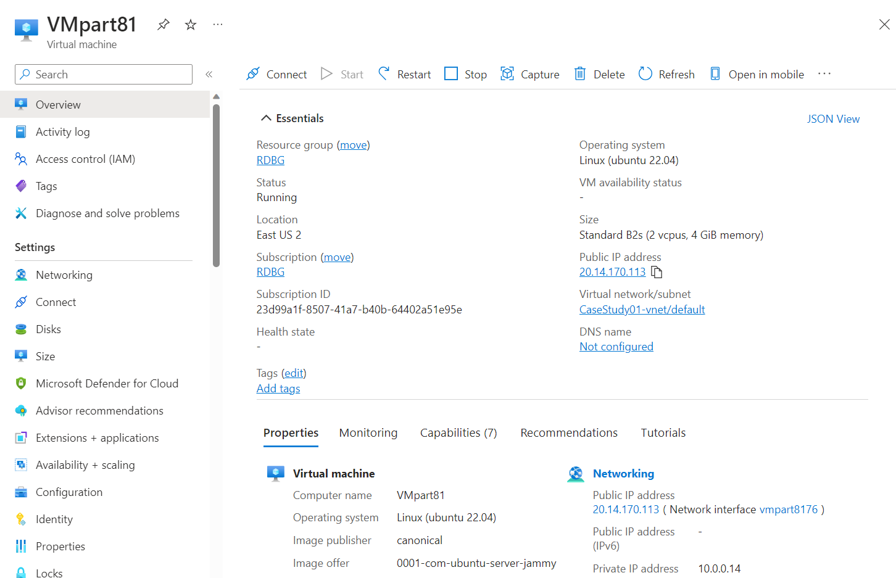
Project Management
Creating Azure VM

Slide 17
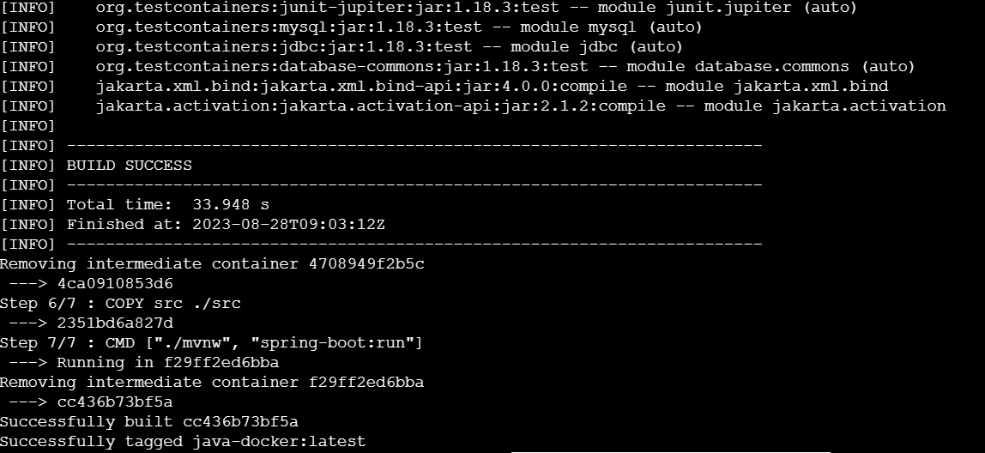
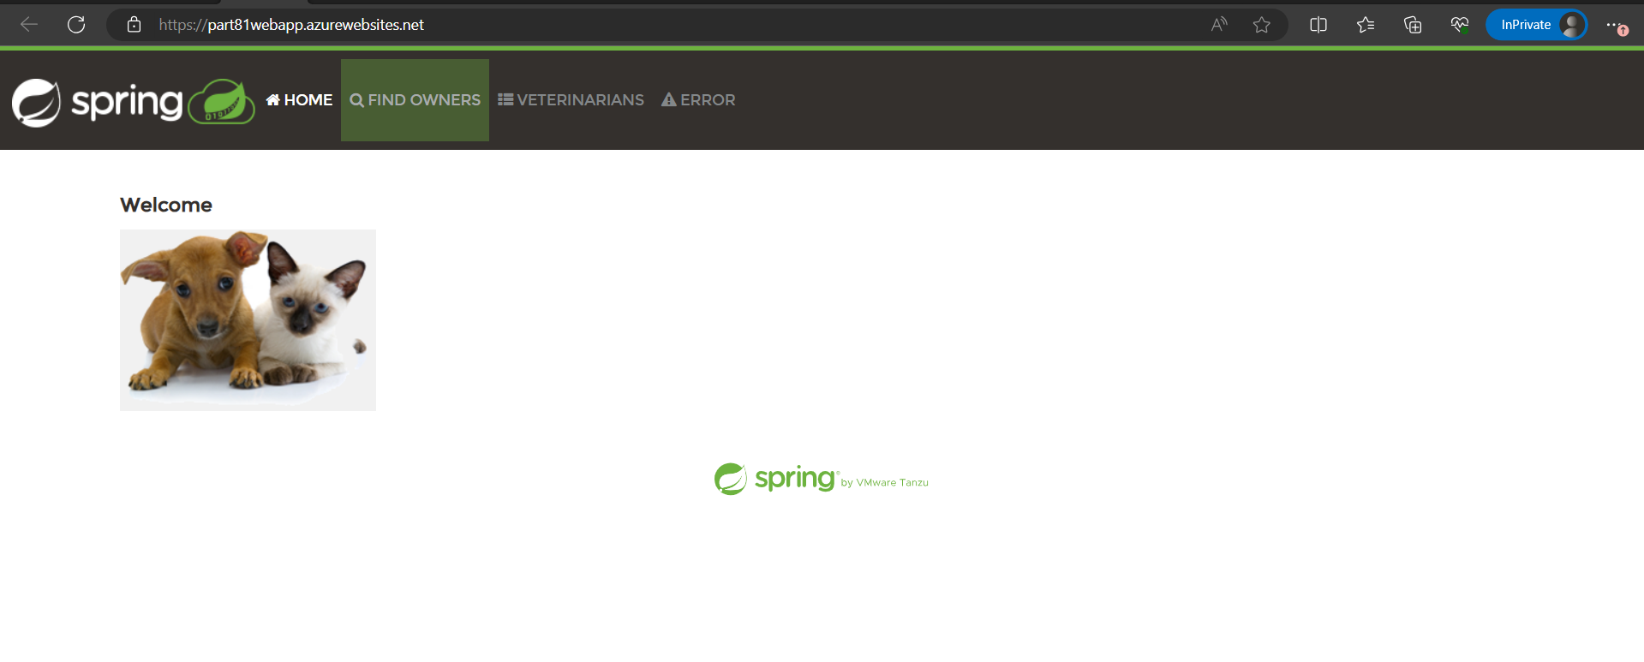
Docker Images
Deployed Web App

